Slide 1
Emerald Voluntary Political Survey
22 Responses
Anonymous
No double responses allowed
Sent to Tacoma office employees only
11.17.2016

Slide 2
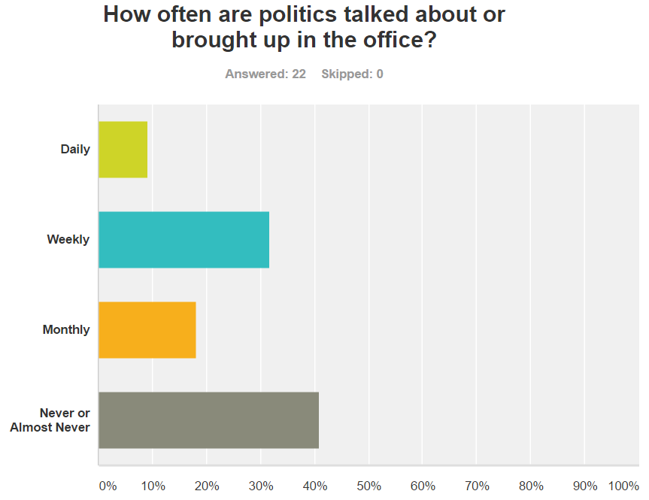

Slide 3
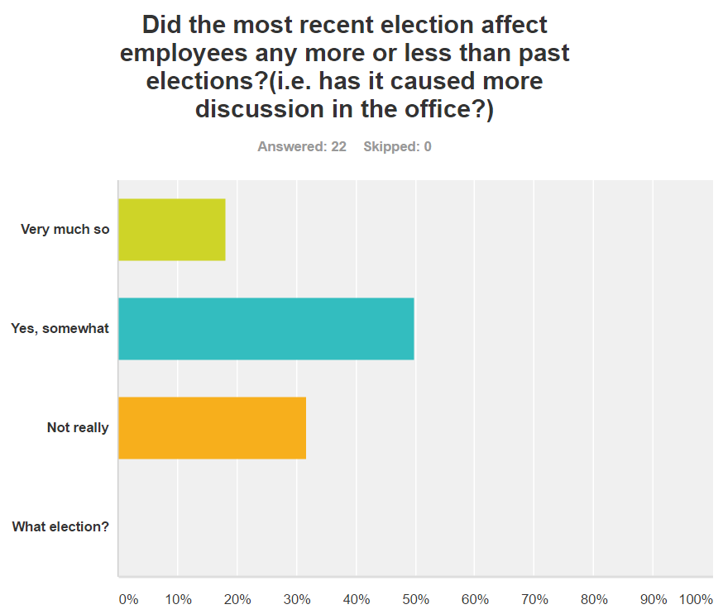

Slide 4
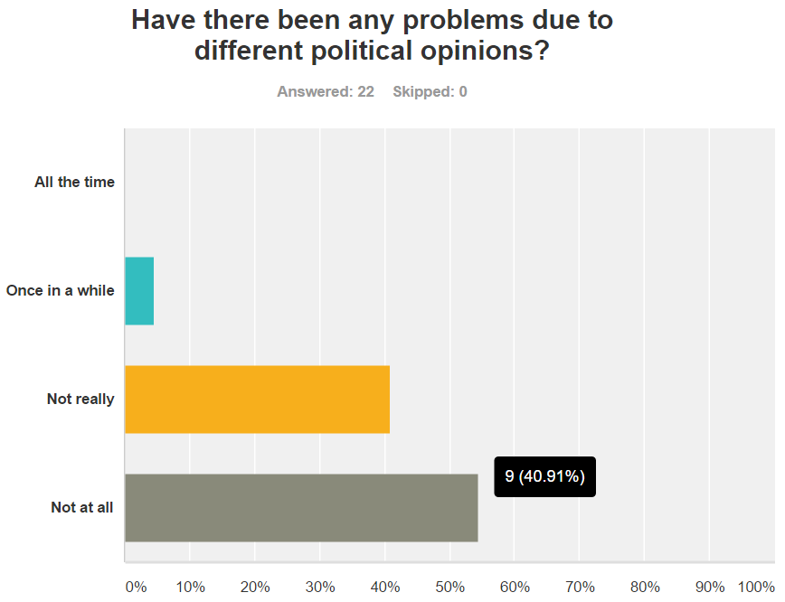

Slide 5
